Slide 1
CSE470: Software Engineering
Waterfall Model

Slide 2
What is a Waterfall Model?
A sequential methodology for software project management.
There are times when the requirements for a problem are well understood—when work flows from communication through deployment in a reasonably linear fashion.
It is also called the Classic Life Cycle

Slide 3
When does it occur?
This situation is sometimes encountered when well-defined adaptations or enhancements to an existing system must be made
Example: An adaptation to accounting software that has been mandated because of changes to government regulations
It may also occur in a limited number of new development efforts, but only when requirements are well defined and reasonably stable.

Slide 4
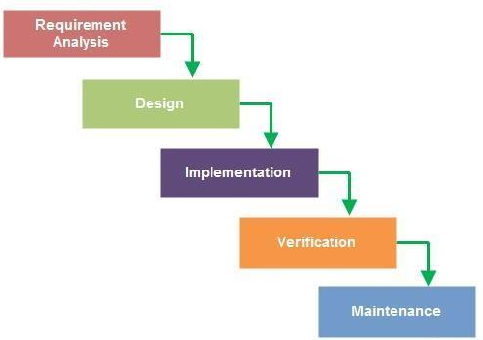
Steps of the Waterfall Model
Requirement Collection & Analysis
Design
Coding/Implementation
Testing/Verification
Deployment
Maintenance

Slide 5
Requirement Analysis
In this phase, all the requirements are gathered from the client. Basically collecting information about what the client wants their software to do. Then our job is to:
Address the problem
Identify feasible and infeasible requirements
Identify how the software helps our client attain their requirements

Slide 6
Design
In this step, the requirements gathered in the previous step is converted into different format (Diagrams) that can be coded in a programming language.
It usually includes a high level and detailed design and architecture of the proposed software solution.

Slide 7
Development/Coding
After the design is fixed:
The design is converted into blocks
Those blocks are converted into code
Step by step converting the design to a workable software

Slide 8
Testing
Testing phase starts after the development phase is completed.
The finished product is tested based on the user requirements
In case of any problem, it is fixed in code (Unit Testing)
It is usually done in several phases

Slide 9
Deployment
The software is deployed in the production environment
Test to check if the system is performing as expected

Slide 10
Maintenance
If anything goes wrong in the deployment process, it is fixed here
Keeping the software working over time

Slide 11
Advantages of Waterfall Model
Easy to Understand and Implement
Each Step is properly defined
Steps are performed one at a time
Clear goals of each step

Slide 12
Disadvantages of Waterfall Model
No feedback path
Difficult to incorporate requirement changes
No step overlapping
Not flexible
Limited Stakeholder Involvement
Late error detection
Working product after the last step of the model

Slide 13
When to choose Waterfall Model
When Requirements are well known
Little to no changes expected
Small to Medium Projects
Minimum Client Involvement needed
Resources are available and trained
The Waterfall approach involves less user interaction in the product development process. The product can only be shown to end user when it is ready.

Slide 14
Case Study
Case 1: One of your uncle requested you to develop an accounting calculator for his local shop.
Case 2: Your start-up company wants to develop an accounting calculator for super shops.
Question: Determine if you can implement both cases in Waterfall Model

Slide 15
Case 1
One of your uncle requested you to develop an accounting calculator for his local shop.
Key Points to note:
Local shop (Small scale)
Already existing business (Fixed Requirement)
Verdict: Waterfall can be Implemented

Slide 16
Case 2
Your company wants to develop an accounting calculator for start-up super shops.
Key Points to note:
Super shop (Big scale)
Start up (Requirements are not fixed)
Verdict: Cannot implement Waterfall Model

Slide 17
References
Roger S Pressman, Roger Pressman,"Software Engineering: A Practitioner's Approach", McGraw-Hill, 7th edition, 2010.
https://www.geeksforgeeks.org/waterfall-model/

